Slide 1
CHAPTER - XI COMPUTER NETWORKS I

Slide 2

Class XII
Unit I
Programming and Computational Thinking (PCT-2)
(80 Theory + 70 Practical)
Prepared by
Praveen M Jigajinni
DCSc & Engg, PGDCA,ADCA,MCA.MSc(IT),Phd(biology),MBBS,Mtech(IT),MPhil (Comp. Sci)
Department of Computer Science, Sainik School Amaravathinagar
Cell No: 9431453730

Slide 3
INTRODUCTION
Subject | Max Marks | Avg Marks | Grade
English | 100 | 80 | B
Hindi | 100 | 91 | A+
Maths | 100 | 85 | B+
PH.E | 200 | 175 | A
History | 100 | 79 | C+

Slide 4
INTRODUCTION
What is Computer Network?
A computer network is a set of computers connected together for the purpose of sharing resources. The most common resource shared today is connection to the Internet. Other shared resources can include a printer or a file server. The Internet itself can be considered a computer network

Slide 5
ADVANTAGES OF COMPUTER NETWORK

Slide 6
ADVANTAGES OF COMPUTER NETWORK
1. IT ENHANCES COMMUNICATION AND AVAILABILITY OF INFORMATION.
2. IT ALLOWS FOR MORE CONVENIENT RESOURCE SHARING.
3. IT MAKES FILE SHARING EASIER.

Slide 7
ADVANTAGES OF COMPUTER NETWORK
4. IT IS HIGHLY FLEXIBLE.
5. IT IS AN INEXPENSIVE SYSTEM.
6. IT BOOSTS STORAGE CAPACITY.

Slide 8
DISADVANTAGES OF COMPUTER NETWORK

Slide 9
DISADVANTAGES OF COMPUTER NETWORK
1. IT LACKS INDEPENDENCE.
2. IT POSES SECURITY DIFFICULTIES.
3. IT LACKS ROBUSTNESS.

Slide 10
DISADVANTAGES OF COMPUTER NETWORK
4. IT ALLOWS FOR MORE PRESENCE OF COMPUTER VIRUSES AND MALWARE.
5. IT REQUIRES AN EFFICIENT HANDLER.
6. IT REQUIRES AN EXPENSIVE SET-UP.

Slide 11
COMPONENTS OF COMPUTER NETWORK

Slide 12
COMPONENTS OF COMPUTER NETWORK
1. HUBS
2. SERVERS
3. CLIENT
4. COMMUNICATION CHANNEL

Slide 13
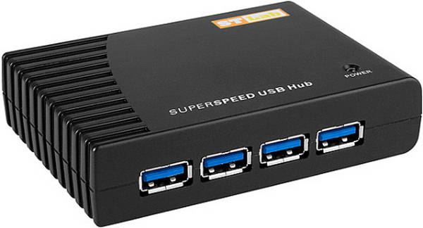
COMPONENTS OF COMPUTER NETWORK
1. HUBS

Slide 14
COMPONENTS OF COMPUTER NETWORK
1. HUBS
A network host is a computer or other device connected to a computer network. A network host may offer information resources, services, and applications to users or other nodes on the network.
There are two types of hub:
(I) ACTIVE HUB
(II) PASSIVE HUB

Slide 15
(I) ACTIVE HUB
it’s electrically amplify the signal as it moves from one connected device to another.
(ii)active concentrators are used like repeaters to extend the length of the network.

Slide 16
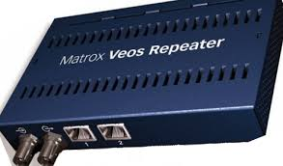
REPEATERS:
it’s an device that electrically amplifies the signal it receives and rebroadcasts it.

Slide 17
(ii) PASSIVE HUB
It allows the signal to pass from one computer to another without any change.

Slide 18
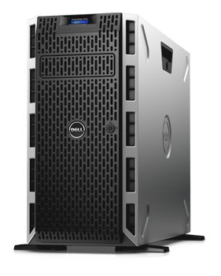

COMPONENTS OF COMPUTER NETWORK
2. SERVERS

Slide 19
COMPONENTS OF COMPUTER NETWORK
2. SERVERS
A server is a type of computer or device on a network that manages network resources. Servers are often dedicated.

Slide 20
COMPONENTS OF COMPUTER NETWORK
3. CLIENT(S)

Slide 21
COMPONENTS OF COMPUTER NETWORK
3. CLIENT
A client is a piece of computer hardware or software that accesses a service made available by a server.

Slide 22
COMPONENTS OF COMPUTER NETWORK
4. COMMUNICATION CHANNEL

Slide 23
COMPONENTS OF COMPUTER NETWORK
4. COMMUNICATION CHANNEL
A communication channel or simply channel refers either to a physical transmission medium such as a wire, or to a logical connection over a multiplexed medium such as a radio channel in telecommunications and computer networking

Slide 24
COMPONENTS OF COMPUTER NETWORK
4. COMMUNICATION CHANNEL
Types of communication channels are:
1. WIRED OR GUIDED COMMUNICATION CHANNEL
2. WIRELESS OR UNGUIDED COMMUNICATION CHANNEL

Slide 25
4. COMMUNICATION CHANNEL
1. WIRED OR GUIDED COMMUNICATION CHANNEL

Slide 26
1. WIRED OR GUIDED COMMUNICATION CHANNEL
When host and server with one another through guided media
Like ,network cables like it’s called wired communication channels/medium
Example:
TWISTED-PAIR CABLES
COAXIAL CABLES
FIBRE OPTICAL CABLE .

Slide 27
4. COMMUNICATION CHANNEL
2. WIRELESS OR UNGUIDED COMMUNICATION CHANNEL

Slide 28
2. WIRELESS OR UNGUIDED COMMUNICATION CHANNEL
When hosts and server are connected with one another through guided media. Like, radio waves ,satellite etc.,
Example of wireless communication:
RADIO WAVE ,
MICRO WAVE,
SATELLITE etc.,

Slide 29
TYPES OF NETWORK

Slide 30
TYPES OF NETWORK
A computer network means a group of ‘network’ Computers
A network can mean a small of linked computers to a chain of a few hundred computer of different types (eg , PCs, minis, mainframes etc ) Spread around the world.

Slide 31
TYPES OF NETWORK BASED ON GEOGRAPHICAL SPREAD
Based on network span or geographical spread , network can be divided into two types:
(I)LAN (LOCAL AREA NETWORK)
(II)WAN(WIDE AREA NETWORK)

Slide 32
TYPES OF NETWORK BASED ON GEOGRAPHICAL SPREAD
LAN(LOCAL AREA NETWORK)

Slide 33
LAN (LOCAL AREA NETWORK)
Small computer network that are confined to a localised are a ( eg ; an office , a building or a factory) are known as LAN’s.
The key purpose of LAN is to serve its users in resource sharing .
The hardware as well as software resources are shared through LAN’s.
LAN users can share data , information , programs , printers , modems ,etc.,

Slide 34
TYPES OF NETWORK BASED ON GEOGRAPHICAL SPREAD
WAN (WIDE AREA NETWORK)

Slide 35
WAN (WIDE AREA NETWORK)
The network spread across countries (or) on a very big geographical area are known as WAN‘s.
It is a group of computers that are separated by a large distance and tied together .
It can be a group of LAN’s that are separated across several locations and connected together to look like one big LAN.
Computers are connected to a wide area network are often connected through public networks such as telephone systems .

Slide 36
LAN
WAN
LAN
WAN

Slide 37
DIFFERENCE BETWEEN LAN & WAN

Slide 38
DIFFERENCE BETWEEN LAN & WAN
S.NO | LAN | WAN
1) | IT IS SPRED OVER A SMALL AREA | IT IS SPREAD OVER A VERY LARGE AREA
2) | IT IS USUALLY COSTS LESS TO SET IT UP | IT COSTS HIGHER TO SET IT UP
3) | IT IS USUALLY A SINGLE NETWORK | IT IS USUALLY A NETWORK OF MANY NETWORK

Slide 39
TYPES OF NETWORK BY COMPONENTS

Slide 40
TYPES OF NETWORK BY COMPONENTS
Another parameter based on which you can classify networks is the role played by network computers in the network operations on basis , there are 2 types of networks:
(I) PEER TO PEER NETWORKS
II) CLIENT / SERVER NETWORKS

Slide 41
TYPES OF NETWORK BY COMPONENTS
PEER TO PEER (P2P) NETWORKS

Slide 42
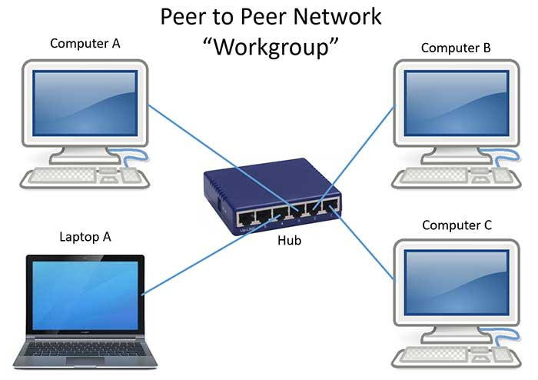
PEER TO PEER (P2P) NETWORKS

Slide 43
PEER TO PEER (P2P) NETWORKS
P2P network literally implements the meaning word Peer (ex : Each computer on P2P network is equal) , that is each computer can play a role of a client or a server.
The computer that serve on P2P computers are often termed as non-dedicated servers
Contd….

Slide 44
PEER TO PEER (P2P) NETWORKS
(P2P) networks are popular as home networks and for use in small companies as they are inexpensive and easy to install ,but they are limited scope and are difficult to secure.
On small networks , workstation that can double up as a server is known as
NON-DEDICATDED SERVER .
Non–Dedicated Server can shuttle b\w client as well as server role.
Small networks that are using such a servers are known as P2P networks.

Slide 45
TYPES OF NETWORK BY COMPONENTS
CLIENT / SERVER NETWORKS

Slide 46

CLIENT / SERVER NETWORKS

Slide 47
CLIENT / SERVER NETWORKS
Unlike P2P networks , bigger networks prefer to have centralised control .
They do this by clearing designations servers and clients such networks are called
CLIENT-SERVER NETWORKS (or)
MASTER-SLAVE NETWORKS.
On bigger network installation , there is a computer reserved for the server’s job and its only job is to help workstations access the data, software , hardware resources . CONTD…

Slide 48
CLIENT / SERVER NETWORKS
It does not double up as workstation and such servers is known as dedicated servers.
Dedicated servers operates solely as a server on a network.
For ex : There may be a server exclusively for serving files – related requests like storing files deciding about their access privileges & regulating the amount of space allowed for each server.

Slide 49
DIFFERENCE BETWEEN CLIENT SERVER AND P2P

Slide 50
DIFFERENCE BETWEEN CLIENT SERVER AND P2P
SERVICE | CLIENT SERVER | P2P
SECURITY | The server controls security of network | No central control over security
MANAGEMENT | The server manages the network . Needs a dedicated team of people to manage the server . | No central control over the network . Any one can set up.

Slide 51
DIFFERENCE BETWEEN CLIENT SERVER AND P2P
SERVICE | CLIENT SERVER | P2P
DEPENDENCY | Clients are depend on the servers. | Clients are not depend on central servers.

Slide 52
DIFFERENCE BETWEEN CLIENT SERVER AND P2P
SERVICE | CLIENT SERVER | P2P
PERFORMANCE | The server can be upgraded to be made more powerful to cope with high demand. | If machines on the network are slow they will slow down other machines.
BACKUPS | Data is all backed up on the main server . | Each computer has to be backed up Data can easily be deleted by users .

Slide 53
TYPES OF NETWORK BASED ON COMMUNICATION CHANNEL
Computer networks are formed when computers are connected with one and other . The connections among the hosts are established using specific communication media.
The computer networks can be categorized as these:
1. WIRED COMPUTER NETWORKS
2. WIRELESS COMPUTER NETWORKS

Slide 54
TYPES OF NETWORK BASED ON COMMUNICATION CHANNEL
1. WIRED COMPUTER NETWORK

Slide 55
WIRED COMPUTER NETWORK
As clear by name in wired computer networks , the host and other devices are interconnected through wiring or cables. Most wired computer networks are of LAN type .
Although , there are wireless LAN’s too and there are bigger networks that used wireless medias too.
Contd..

Slide 56
WIRED COMPUTER NETWORK
Commonly used cables in wired networks are one of the following three types:
A) TWISTED PAIR CABLE
B) COAXIAL CABLE (COAX)
C)FIBRE OPTIC CABLE (OPTIC FIBRE CABLE).

Slide 57
TYPES OF NETWORK BASED ON COMMUNICATION CHANNEL
TYPES OF WIRED CABLES
A) TWISTED PAIR CABLE:

Slide 58
TYPES OF WIRED CABLES
A) TWISTED PAIR CABLE:
A twisted pair cable is a pair of insulated wires that are twisted together to improve electromagnetic capability and to reduce from outside source these available in various forms such as CAT1 , CAT2 , CAT3 , CAT4 , CAT5 , CAT6

Slide 59
TYPES OF NETWORK BASED ON COMMUNICATION CHANNEL
TYPES OF WIRED CABLES
B) COAXIAL CABLE (COAX)

Slide 60
TYPES OF WIRED CABLES
B) COAXIAL CABLE (COAX)
This type cables consist of a solid wire core surrounded by one or more foil or wire shield each separated by some kind of plastic insulator
Ex : Thicknet and Thinnet .

Slide 61
TYPES OF NETWORK BASED ON COMMUNICATION CHANNEL
TYPES OF WIRED CABLES
C) FIBRE OPTIC CABLE :

Slide 62
TYPES OF WIRED CABLES
C) FIBRE OPTIC CABLE :
Consist of a bundle of glass threads each of which capable of transmitting messages modulated on to light waves .
Example:
Single node
Multi-node

Slide 63
TYPES OF NETWORK BASED ON COMMUNICATION CHANNEL
WIRELESS COMPUTER NETWORKS

Slide 64
WIRELESS COMPUTER NETWORKS
The computer networks that use environment or air as the media , through which information is transmitted without any cable or wires or the electronic conductor , rather by using electromagnetic waves like: IR(infrared) , RF(radio frequencies) , satellite , etc are wireless computer networks
EXAMPLE: i) When you connect all smartphones to a common WIFI (a wireless LAN )
ii) WAN can also be formed using wireless media such as satellite.

Slide 65
TYPES OF WIRELESS NETWORK

Slide 66
TYPES OF WIRELESS NETWORK
1. MICRO WAVE
2. RADIO WAVE
3. SATELLITE
Some other wireless communication media are :
Infrared waves
Laser waves

Slide 67
TYPES OF WIRELESS NETWORK
MICRO WAVE

Slide 68
MICRO WAVE
Micro waves are high frequency waves that used to transmit data wirelessly over a long distances. The microwave transmission consists of a transmitter , receiver and the atmosphere .
Shorter wavelength than radio waves.
Higher frequency than radio waves.
Higher energy than radio waves.
Examples: Cell Phones and Radar.

Slide 69
TYPES OF WIRELESS NETWORK
RADIO WAVE

Slide 70
RADIO WAVE
Longest wave Length.
Lowest Frequency.
Lowest Energy.
WI-FI that has become common word today also use radio waves to transmit data among connected devices.
Some More Examples: TV,AM,FM Radio Signals.
Radio waves easily travel through the atmosphere and many materials.

Slide 71
SATELLITE

Slide 72
SATELLITE
Satellite communication is a special case of a microwave relay system.
Satellite communication use the synchronous satellite to relay the alien radio signal transmitted from ground station.
The satellite accept data / signals transmitted from an earth station , amplify them , and retransmit them to another station.
Using such as a setup data can be transmitted to other side of the earth in only one step. Contd…

Slide 73
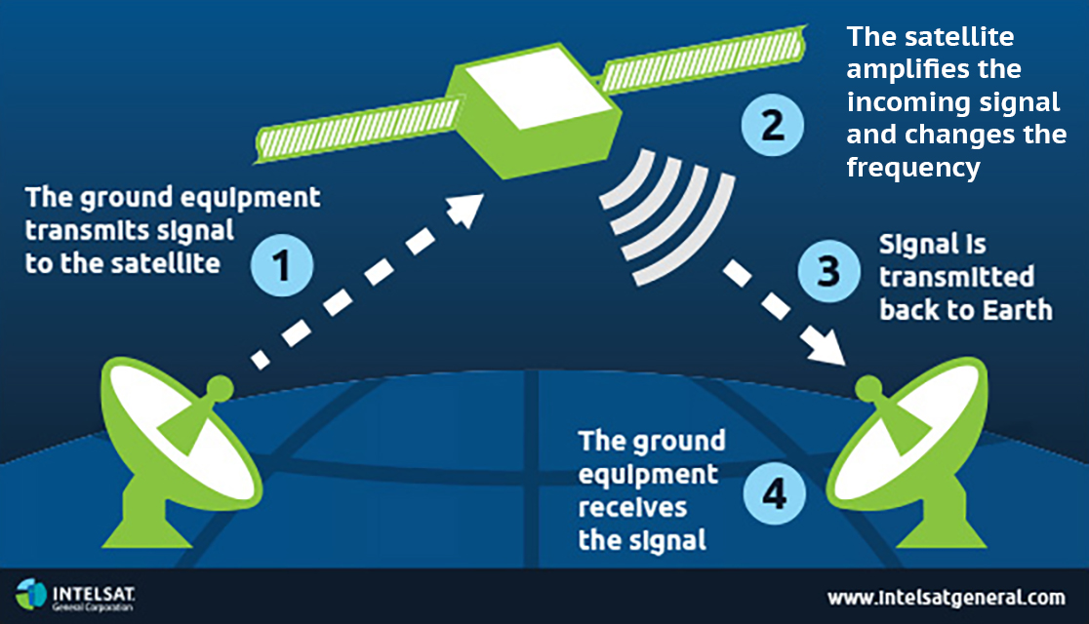
SATELLITE

Slide 74
NETWORK DEVICES AND HARDWARE

Slide 75
NETWORK DEVICES AND HARDWARE
In the smooth functioning of a computer , other than computers and wiring , many devices (or) specialized hardware play important roles .

Slide 76
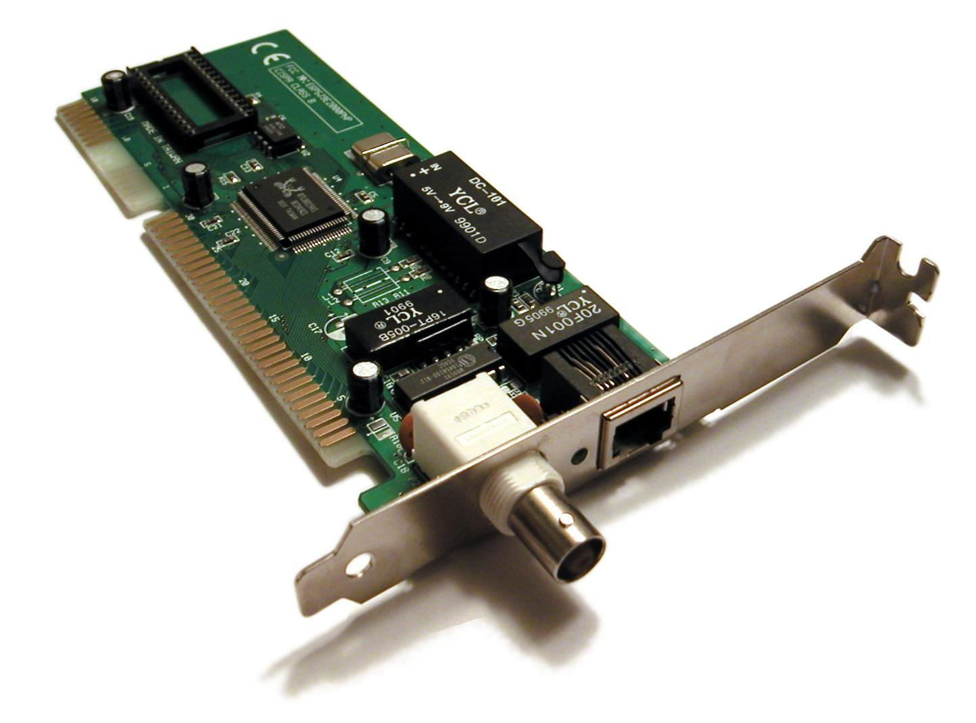
NETWORK INTERFACE CARD (NIC)

Slide 77
NETWORK INTERFACE CARD (NIC)
A standalone computer (a computer that does not attached to a network) lives in its own world and carries out its tasks with its own inbuilt resources.
The (NIC) is a device that is attached to each of the workstations and the server & helps the workstation to establish all the important connections with network.
Each NIC that is attached to a workstation has a unique number identification which is known as note address
Contd…

Slide 78
NETWORK INTERFACE CARD (NIC)
The NIC is also called as Terminal Access Point (TAP) different manufacturers have different name for the interface .
The NIC is also called as NIU – (Network Interface Unit)
The (NIC) manufacturers assigns a unique physical address to each NIC-card , this physical address is know as MAC-address ------ (Media Access Control)

Slide 79
MAC ADDRESS

Slide 80
MAC ADDRESS
The (NIC) manufacture assigns a unique physical address to each NIC-card , the physical address is know as (MAC-Address) .
A MAC-Address is a 6-bytes with each byte separated by an colon
Eg;
10 : B5 : 03 : 63 : 2E : FC
Contd..

Slide 81
MAC ADDRESS
MAC-address is actually an number assigned to the network card of your computer .
The first three bytes are “manufacturer—ID” and the last three byte are the card—no .
Eg; Manufacturer--ID
10 : B5 : 03 : 63 : 2E : FC
Card-no

Slide 82
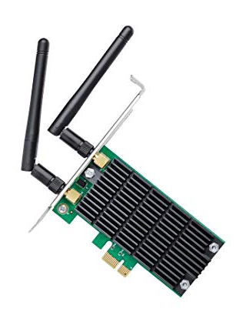
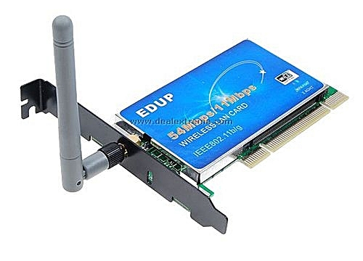
WI-FI CARD

Slide 83
WI-FI CARD
It’s either an internal (or) external local area network adapter with a built-in wireless radio and antenna.
Most common WI-FI cards used in desktop computers are PCI express WI-FI cards made to fit the PCI express cards slots on the mother board .
The primary benefit of using a WI-FI card in desktop computer is that it allows you to set-up your workstation (or) home office without considering the proximity (or) availability of hard line network access

Slide 84
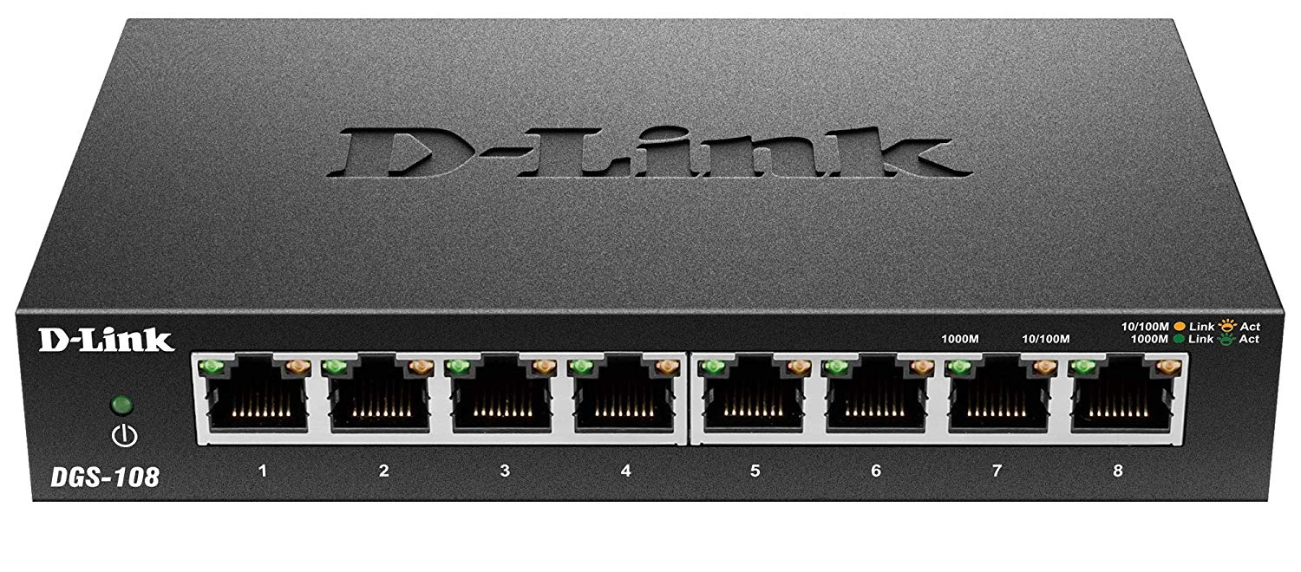
SWITCH

Slide 85
SWITCH
A switch is a device that is used to segment networks into different subnetworks called subnet or LAN Segment.
Segmenting the network into smaller subnet, prevents traffic overload in a network.
A switch is responsible for filtering (or) transforming data in a specific way and forwarding packets between LAN segment.
Contd…

Slide 86
SWITCH
A switch can support any packet of protocol.
LAN’s that are segmented through switches are called as switched LANs.

Slide 87
BRIDGE

Slide 88
BRIDGE
A bridge is a device that let’s you link networks together.
Bridges are smart enough to know which computers are on which side of the bridge, so they only allow those messages that need to get other side to cross the bridge.
Bridges can handle networks that follow same protocol.
Contd..

Slide 89
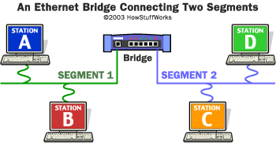
BRIDGE

Slide 90
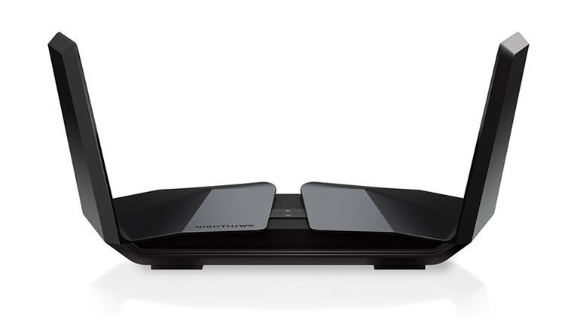
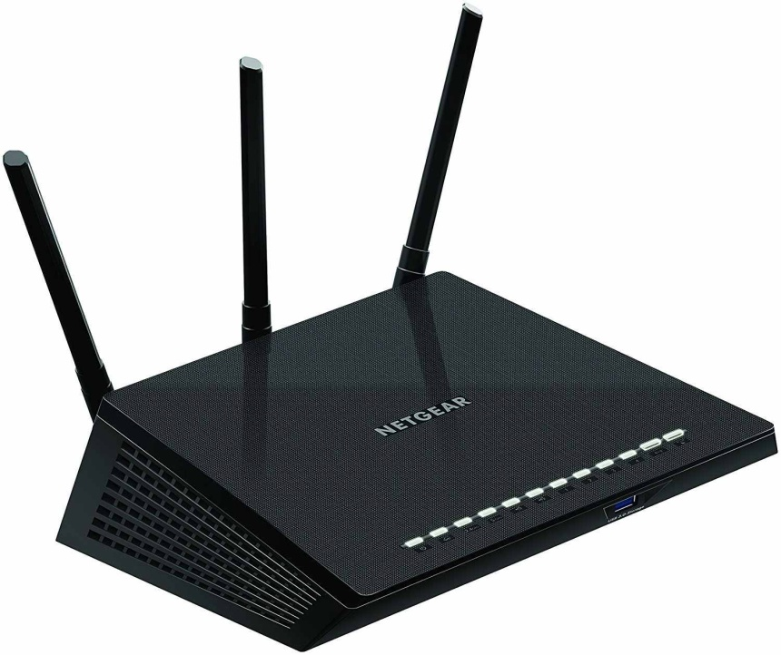
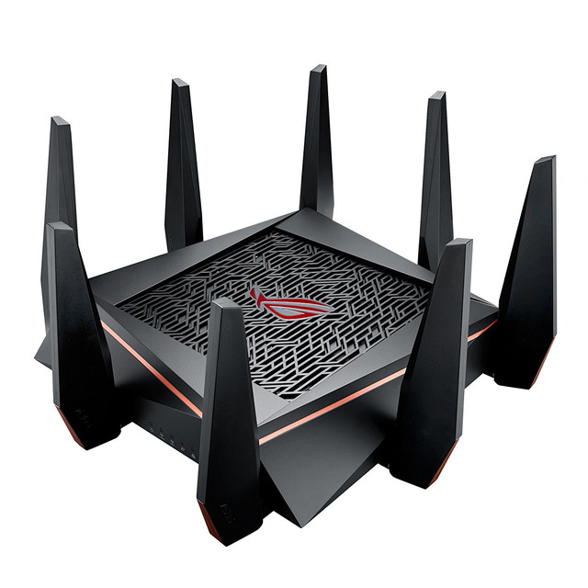
ROUTER

Slide 91
ROUTER
A device that works like a bridge but can handle different protocol is know as Router.
A Router is a network device that forwards data from one network to another network.
A router works like a bridge but can handle different protocols.

Slide 92
ROUTER
If the destination is unknow to a router it sends the traffic to another router (using logical address) which knows the destination, Based on a network road map called as (Routing Table).
Routers can help to ensure that packets are travelling the most efficient paths to their destination.

Slide 93
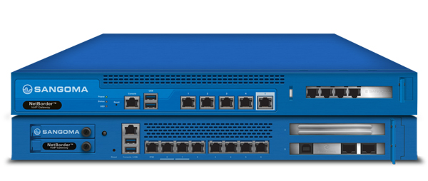
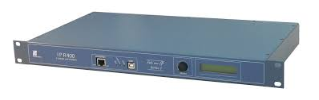
GATEWAY

Slide 94
GATEWAY
A gateway is a network device that connects dissimilar networks.
It establishes an intelligent connection between a local network and external network with completely different structures
Gateway is actually a node on a network that server as an entrance to another network.
In enterprises the gateway is the computer that routes the traffic from workstation to a out side network that serving the web pages.

Slide 95
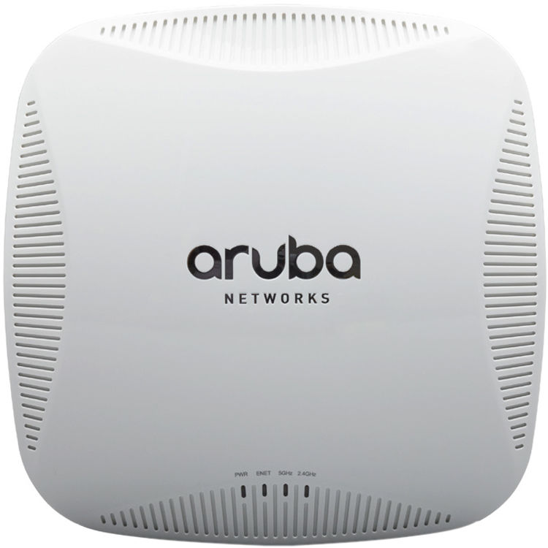
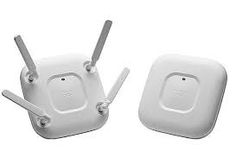
ACCESS POINT(AP) / WIRELESS ACCESS POINTS

Slide 96
ACCESS POINT(AP)
An ACCESS POINT-(AP) , also called as (Wireless access point) WAP
WAP is a hardware device that establishes connections of computer devices on wireless LAN with a fixed wire network.
AP is a station that transmits and receives data
AP has a range of (up to 150 feet for home based APs).
Wireless routers can function as(AP) , but not all (AP)can work as routers.

Slide 97
THE CLOUDS

Slide 98
THE CLOUDS
A cloud is a generic term used for “INTERNET”.
Cloud computing is internet-based computing whereby shared resources, software , and information are provided to computer and other devices are in demand, like electricity grid.
Cloud computing is a new name for an old concept :the delivery of computing services from a remote location .

Slide 99
CLOUD COMPUTING
VISUAL
DESKTOP
SOFT WARE PLATFORM
SERVER
APPLACATION
STORAGE/DATA
OS
NETWORK DIVECES
NETWORK DIVECESC
END USERS

Slide 100
TYPES OF CLOUDS
1. PRIVATE CLOUDS
2. PUBLIC CLOUDS
3. COMMUNITY CLOUDS
4. HYBIRED CLOUDS

Slide 101
1.PRIVATE CLOUDS

Slide 102
1.PRIVATE CLOUDS
These are the clouds for exclusive use by single organization and typically controlled, managed and hosted in private data centers.
The hosting and operation of private clouds may also be outsourced to third party services provider, but a private clouds remains for the exclusive use of one organization.
Contd…

Slide 103
1.PRIVATE CLOUDS
Best Private Cloud Providers
HPE. By most estimates, Hewlett Packard Enterprise (HPE) is a key leader in the private cloud market.
Vmware Dell Oracle
IBM Microsoft. Cisco.
NetApp.

Slide 104
2.PUBLIC CLOUDS

Slide 105
2.PUBLIC CLOUDS
These are the clouds for use by multiple organization on shared basis and hosted and by the third party services provider.
Examples of public clouds include Amazon Elastic ComputeCloud (EC2), IBM's Blue Cloud, Sun Cloud,Google AppEngine and Windows Azure Services Platform

Slide 106
3.COMMUNITY CLOUDS

Slide 107
3.COMMUNITY CLOUDS
These are the clouds for use by a group of related organization who wish to make use of a common cloud computing environment .
FOR EXP:
All suppliers to a larger manufacture.
All universities in a given region.

Slide 108
4.HYBRID CLOUDS

Slide 109
4.HYBRID CLOUDS
When a single organization adopts both private and public clouds for a single application in order to take advantage of the benefits of both.

Slide 110
INTERNET OF THING (IoT)

Slide 111
INTERNET OF THING (IoT)
(IoT) is a phenomenon that connects the things to the internet over wired or wireless connections.
(IoT) allows the people and things to be connected ANYTIME, ANYPLACE WITH ANYTHING AND ANYONE .
Contd…

Slide 112
SMART CITIES:
WATER DISTRIBUTION
ENERGY MANAGEMENT:
WIRELESS GIRD COMMUNICATION
SMART HOME:
SMART DOOR LOCK
WERABLES:
SMART WATCHES
HEALTH CARE:
PRESSURE MONITOR
IoT
HOME APPLIANCES:
COFFE MAKER
A/C
TRANAPORTATION:
(IoT) MAKES EASY PARKING
AGRICULTURE:
SMART FARMING
SMART MANFACTURING:
INDUSTRIAL COMMUNICATION
CARS:
ENGIN MANAGEMENT

Slide 113
DIFFERENCE BETWEEN PRIVATE AND PUBLIC CLOUDS

Slide 114
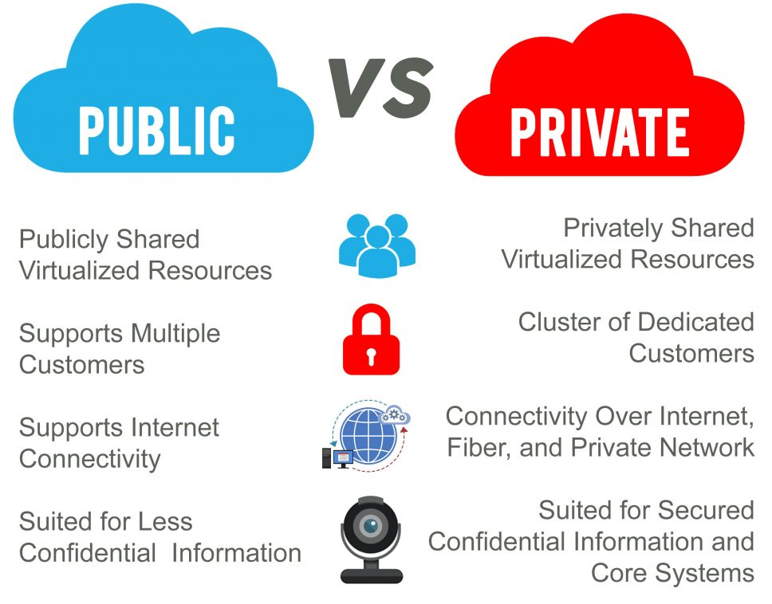

Slide 115
ThankYou

